Slide 4
The main purpose of univariate analysis is to describe the data and find patterns that exist within it.
it doesn’t deal with causes or relationships
Stem-and-leaf plots, which show all data values and the shape of the distribution.
Histograms, a bar plot in which each bar represents the frequency (count) or proportion (count/total count) of cases for a range of values.
Box plots, which graphically depict the five-number summary of minimum, first quartile, median, third quartile, and maximum.

Slide 5
Univariate Data Analysis
Univariate analysis focuses on studying one variable to understand its characteristics
It helps to describe data and find patterns within a single feature.
Various common methods like histograms are used to show data distribution, box plots to detect outliers and understand data spread and bar charts for categorical data.
Summary statistics like mean, median, mode, variance and standard deviation helps in describing the central tendency and spread of the data

Slide 6
Bi-variate Analysis
Bivariate Analysis focuses on identifying relationship between two variables to find connections, correlations and dependencies
It helps to understand how two variables interact with each other.

Slide 7
Bivariate analysis techniques
Scatter Plots
Correlation coefficient
Cross tabulation or contingency tables
Line graph
Covariance

Slide 8
Scatter Plot
These visualizations plot person facts points as dots on a graph, with one variable represented on each axis.
Scatter plots which visualize the relationship between two continuous variables.

Slide 9
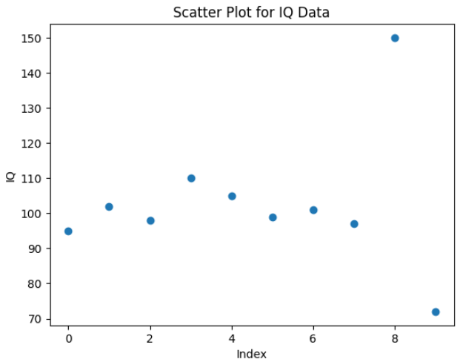
Scatter Plot Cont..
This scatter plot shows most IQ values clustered around 95–110 while the points near 72 and 150 stand out clearly as outliers compared to the rest of the data.

Slide 10
Correlation coefficient
Correlation coefficient measures how strongly two variables are related which commonly use Pearson's correlation for linear relationships.

Slide 11
Cross Tabulation
Cross-tabulation or contingency tables shows the frequency distribution of two categorical variables and help to understand their relationship.

Slide 12
Line Graph
Line graphs are useful for comparing two variables over time in time series data to identify trends or patterns.

Slide 13
Covariance
Covariance measures how two variables change together but it is paired with the correlation coefficient for a clearer and more standardized understanding of the relationship.

Slide 14
Multivariate Analysis
Multivariate Analysis identify relationships between two or more variables in the dataset and aims to understand how variables interact with one another which is important for statistical modeling techniques.

Slide 15
Multivariate Analysis Techniques
Pair Plot
Principal Component Analysis
Spatial Analysis
Time Series Analysis

Slide 16
Pair Plot
shows the relationships between multiple variables at once and helps in understanding how they interact

Slide 17
Principal Component Analysis
reduces the complexity of large datasets by simplifying them while keeping the most important information

Slide 18
Spatial Analysis

Slide 19
Time Series Analysis
used for datasets that involve time-based data and it involves understanding and modeling patterns and trends over time. Common techniques include line plots, autocorrelation analysis, moving averages and ARIMA models.

Slide 20
Violin Plots

Slide 21
Pearson’s correlation coefficients

Slide 22
Spearman’s rank correlation

Slide 23
Lab 05

Slide 24
What is a Perceptron?
A Perceptron is the simplest type of artificial neuron and the foundation of neural networks. It takes multiple inputs, applies weights, sums them, and passes the result through an activation function to produce an output (0 or 1).

Slide 25
Single Layer Perceptron

Slide 26
Mathematical Model of Perceptron

Slide 27
A Multilayer Perceptron (MLP)
A multilayer perceptron (MLP) is a type of feedforward neural network used for tasks like image and speech recognition.
It consists of an input layer, one or more hidden layers and an output layer where each node in a layer is fully connected to every node in the next layer.
MLPs use nonlinear activation function to learn complex, non-linear relationships in data through a process called backpropagation, which adjusts connection weights to minimize errors.

Slide 28
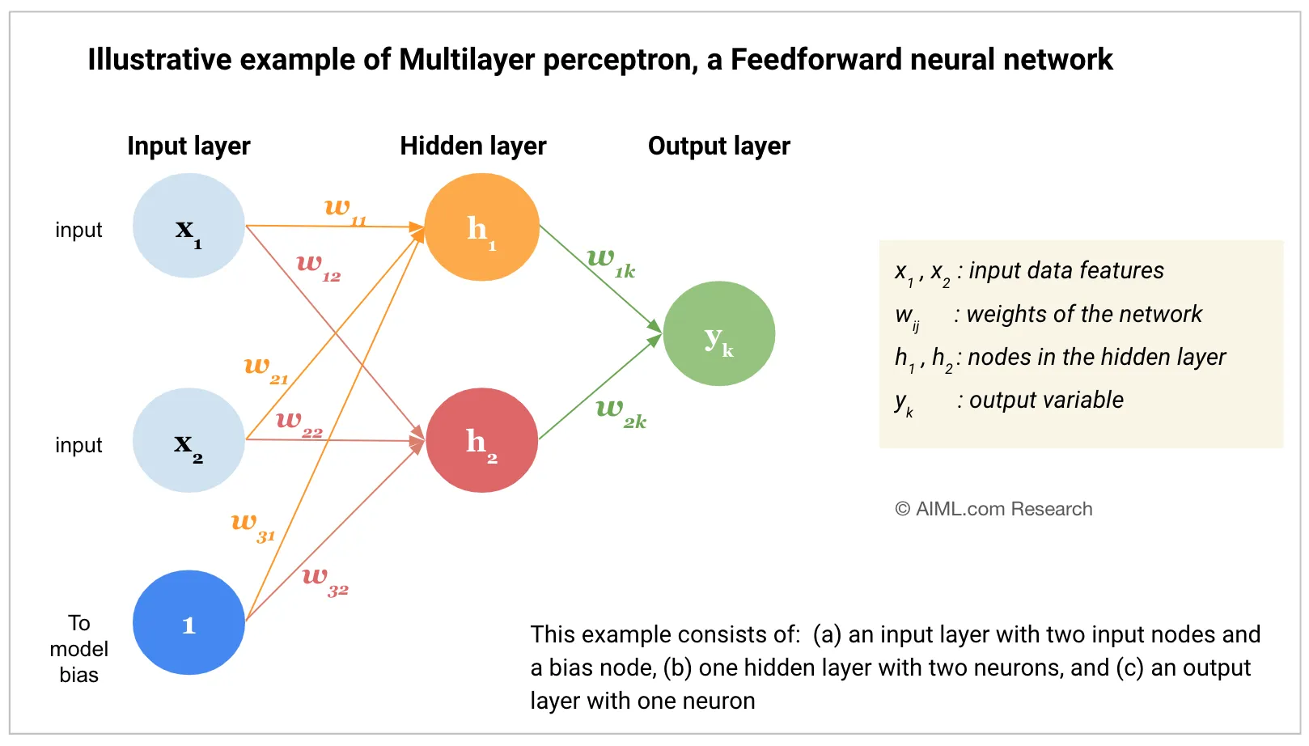

Slide 29
Key components of MLP
Input Layer
Weighted Connection and Biases
Hidden Layers
Activation Function
Forward Propagation
Output Layer
Backpropagation and learning
Iteration and Convergence

Slide 30
Input Layer
The process starts with the input layer, which receives the input data. Each neuron in this layer represents a feature of the input data.

Slide 31
Weighted Connections and Biases
Connections between neurons have associated weights, which are learned during the training process.
These weights determine the strength of the connections and play a crucial role in the network's ability to capture patterns in the data.
In addition, each neuron, in the hidden and output layers has an associated bias term, which allows for fine-tuning and shifting the activation functionʼs threshold.
These weights and biases are parameters that the neural network learns during training.

Slide 32
Hidden Layers
After the input layer, there are one or more hidden layers.
The neurons in these layers perform computations on the inputs.
The output of each neuron is calculated by applying a weighted sum of its inputs (from the previous layer), adding a bias, and then passing this sum through an activation function.

Slide 33
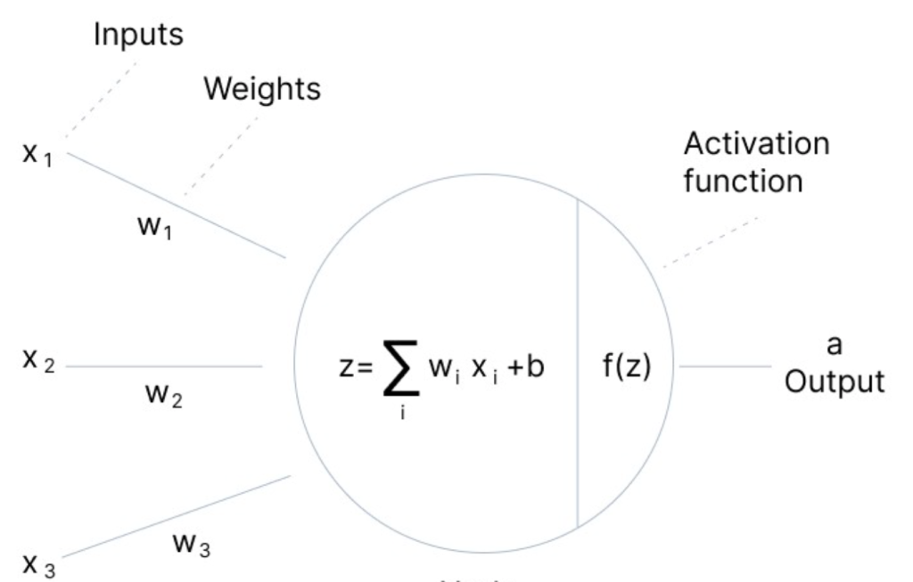

Slide 34
Activation Function
The activation function is crucial as it introduces non-linearity into the model,
allowing it to learn more complex patterns.
Common activation functions include sigmoid, tanh, and ReLU (Rectified Linear Unit).

Slide 35
Forward Propagation
The process from the input layer through the hidden layers to the output layer is called forward propagation.
In each layer, the aforementioned steps (weighted sum, bias addition, activation function) are applied to compute the layer’s output.
In an MLP, information flows in one direction, from the input layer through the hidden layers to the output layer.
There are no feedback loops or recurrent connections, hence the name feedforward architecture.

Slide 36
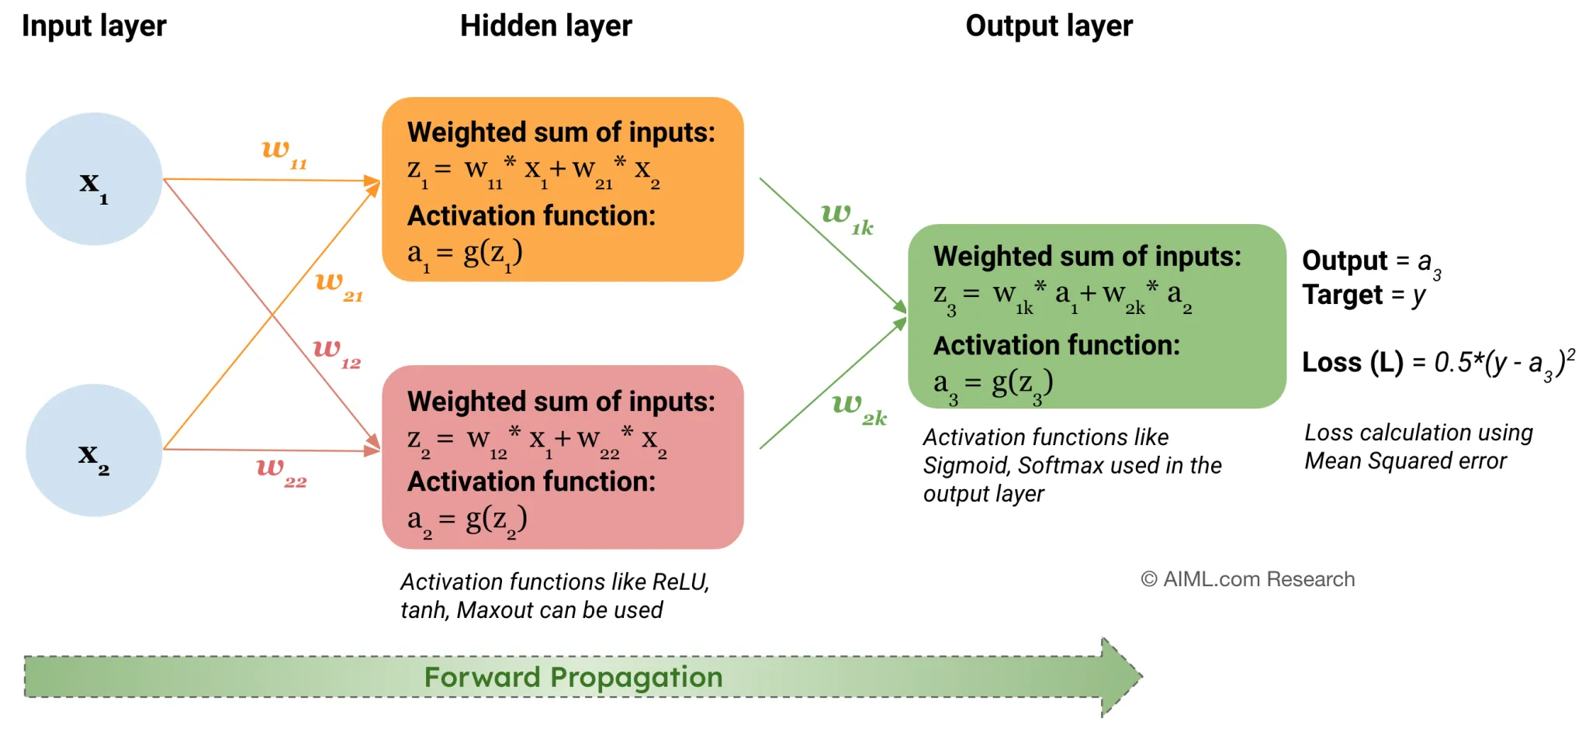

Slide 37
Output Layer
The final layer is the output layer.
In a classification task, this layer often uses a softmax function if the task is multi-class classification, or a sigmoid function for binary classification.
For regression tasks, no activation function might be applied in the output layer.

Slide 38
Backpropagation and Learning
Once a forward pass through the network is completed, the output is compared to the true value to calculate the error.
The error is then propagated back through the network (backpropagation), adjusting the weights and biases to minimize the error.
Backpropagation is typically done using optimization algorithms, such as stochastic gradient descent (SGD) and its variants.

Slide 39
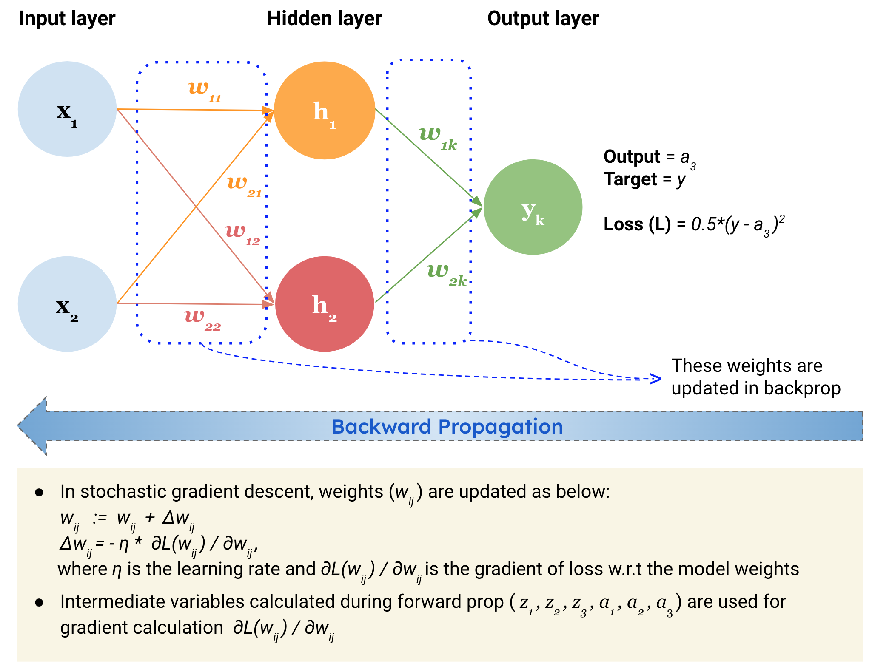

Slide 40
Iteration and Convergence
The process of forward propagation, error calculation, backpropagation, and parameter update is repeated for many iterations over the training data.
Gradually, the network learns to reduce the error, and the weights and biases converge to values that make the network capable of making accurate predictions or approximations.

Slide 41
Applications of MLP
Classification
Regression
NLP Tasks
Anomaly Detection
Speech Recognition
Computer Vision
Data Analytics

Slide 42
Source
https://aiml.com/what-is-a-multilayer-perceptron-mlp/

Slide 43
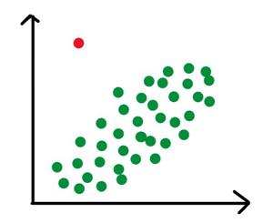
What are outlier?
Outliers are data points that significantly differ from other observations in a dataset, appearing as unusually high or low values that don't follow the general pattern

Slide 44
What are outlier?
They can be caused by measurement or execution errors
Outlier analysis or outlier mining
An outlier cannot be termed as a noise or error.
Outliers can skew results, but they can also highlight fraud (finance), critical patient conditions (healthcare), or new discoveries.
IQR Method: Points beyond \(Q3+1.5\times IQR\) or \(Q1-1.5\times IQR\) are outliers.
Z-Score: Points far from the mean (e.g., >3 or < -3 standard deviations).

Slide 45
Why Outliers Occur?
Data Entry Errors
Measurement Errors
Experimental Errors
Intentional Outliers
Data Processing Errors
Natural Variation

Slide 46
Why Removing Outliers is Necessary?
Impact On Analysis
Outliers can heavily distort statistical measures like the mean, variance and correlation leading to biased or misleading results.
Removing extreme values helps the analysis represent the central trend and typical behavior of the dataset more accurately.

Slide 47
Why Removing Outliers Is Necessary?
Statistical Validity
Outliers can weaken the reliability of hypothesis testing and reduce the performance of predictive models.
Proper handling of outliers improves model stability, accuracy and the trustworthiness of statistical conclusions.

Slide 48
Why Removing Outliers Is Necessary?
Model Performance and Interpretability
Outliers may cause machine learning models to overfit or learn incorrect patterns from rare extreme values.
Eliminating irrelevant outliers makes models easier to interpret and enhances their generalization to new data.

Slide 49
Outliers Identification using Statistical Methods
Statistical methods identify outliers by measuring how far data points deviate from the overall distribution using mathematical thresholds.

Slide 50
Types of outliers
Global (or Point) Outliers
Collective Outliers
Contextual (or Conditional) Outliers

Slide 51
What is Global Outliers?
Global outliers are data points that deviate significantly from the overall distribution of a dataset.
Errors in data collection, measurement errors, or truly unusual events can result in global outliers.
Techniques include statistical methods (e.g., z-score, Mahalanobis distance), machine learning algorithms (e.g., isolation forest, one-class SVM), and data visualization techniques.

Slide 52
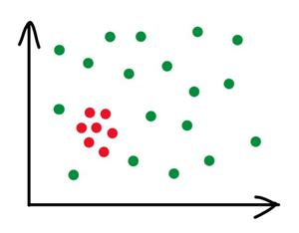
Collective Outliers
Collective outliers are groups of data points that collectively deviate significantly from the overall distribution of a dataset.
Collective outliers may not be outliers when considered individually, but as a group, they exhibit unusual behavior.
Techniques for detecting collective outliers include clustering algorithms, density-based methods, and subspace-based approaches

Slide 53
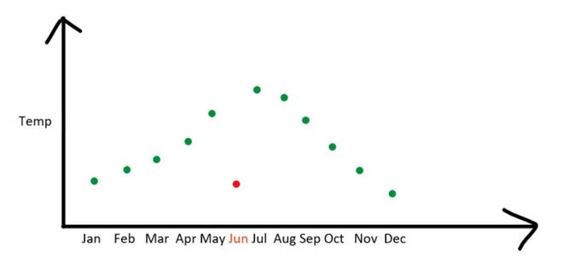
Contextual Outliers
Contextual outliers are data points that deviate significantly from the expected behavior within a specific context or subgroup.
Techniques for detecting contextual outliers include contextual clustering, contextual anomaly detection, and context-aware machine learning approaches.
Contextual information such as time, location, or other relevant factors are crucial in identifying contextual outliers.

Slide 54
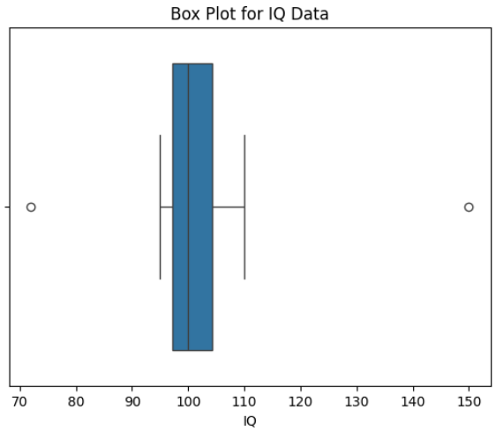
Box Plots
Box plots visually summarize the distribution of a dataset using the median, quartiles and interquartile range (IQR).
Any data points lying beyond the whiskers typically defined as 1.5 times the IQR from the first or third quartile are considered potential outliers.
The box plot shows outliers as points beyond the whiskers, with 72 and 150 indicating unusually low and high IQ values.

Slide 55
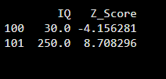
Z-Score
The Z-score method measures how many standard deviations a data point is from the mean of the dataset.
Values with Z-scores greater than +3 or less than −3 are commonly treated as outliers making this approach suitable for normally distributed data.
The output shows that IQ values 30 and 250 lie far from the mean with Z-scores beyond ±3.
This indicates they are extreme outliers significantly different from the rest of the data.

Slide 56

IQR Method
The IQR method defines outliers as values that fall below Q1 − 1.5 × IQR or above Q3 + 1.5 × IQR. Since it does not assume a normal distribution this technique is robust and widely used in real-world datasets.

Slide 57
How to handle Outliers in data?
Removal (Trimming)
Caping or Flooring (Quantile-Based Treatment)
Mean/Median Imputation
Transformation

Slide 58
When to Drop of Keep Outliers

Slide 59
When you should drop outliers
When the values is clearly incorrect
When you have a large dataset
When verification is possible

Slide 60
When you should not drop outliers
When results are critical or high-risk
When many outliers are present
When outliers represent real phenomena

